Slide 1
How to calculate CI?

Slide 2

Example 1:Two proportions

Slide 3
Research Question
What is the difference in population proportions of parents reporting that their children age 6-18 have had swimming lessons between white children and black children?

Slide 4
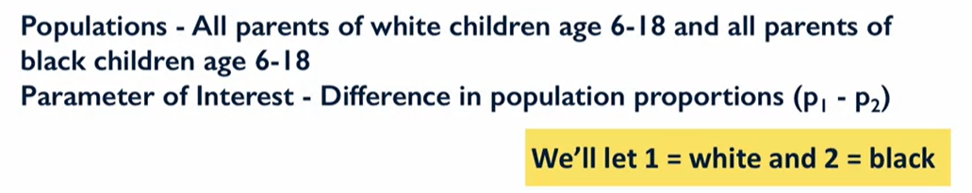
Population and parameter of interest

Slide 5
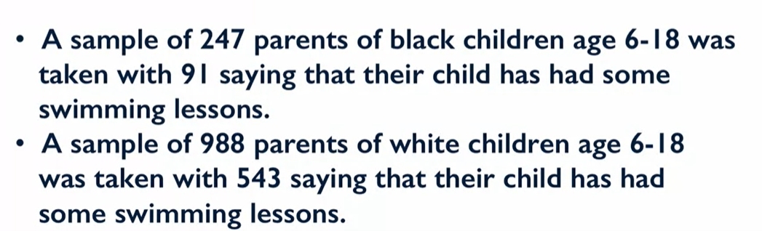
Survey results

Slide 6
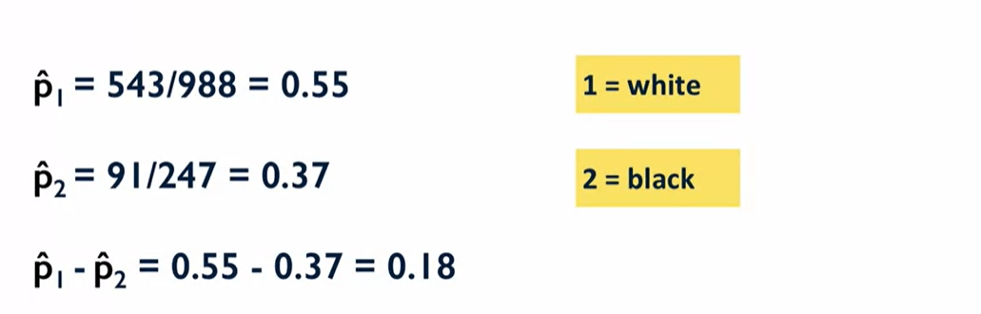
Best estimates of the parameters

Slide 7
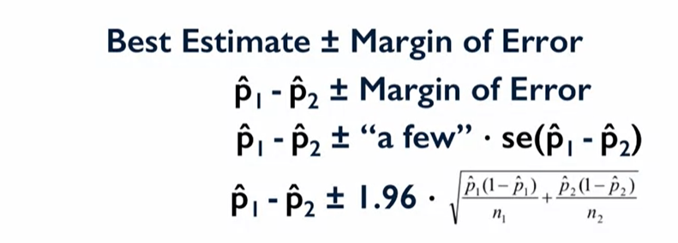
CI Calculation using standard margin of error

Slide 8
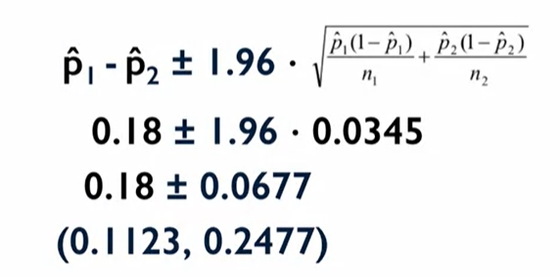
CI Calculation using standard margin of error

Slide 9
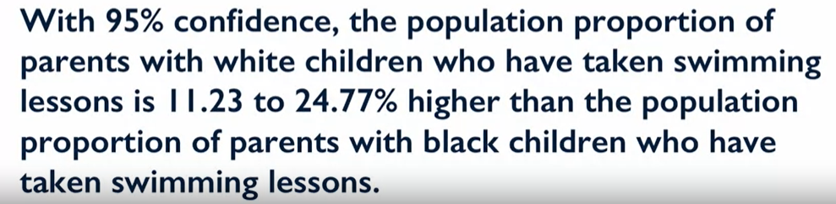
CI Interpretation

Slide 10

Example 2 : One Proportion

Slide 11
Research Question
Construct a 95% confidence interval for the population proportion of parents reporting they use a car seat for all travels with their toddler?

Slide 12
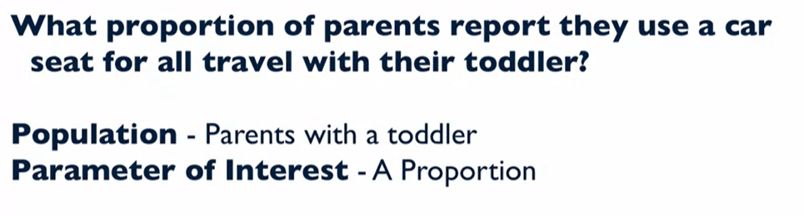
Population and Parameter of Interest

Slide 13
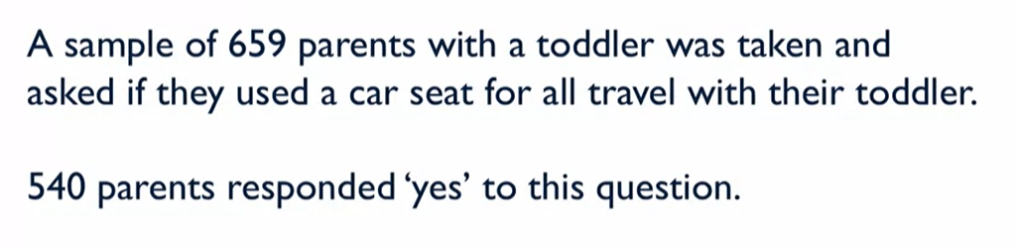
Survey Results

Slide 14
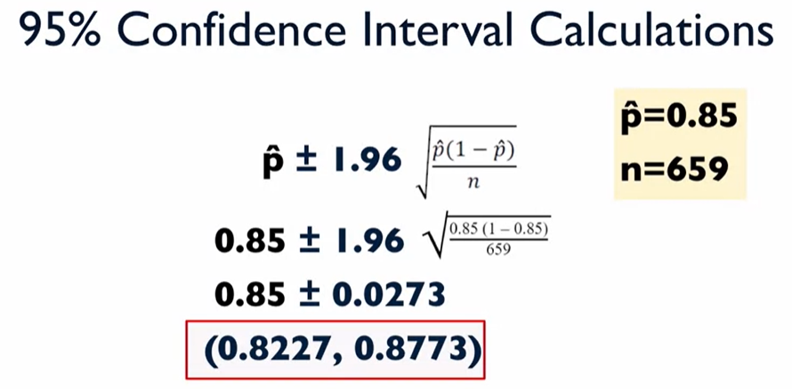
CI Calculation using standard margin of error

Slide 15

CI Interpretation

Slide 16
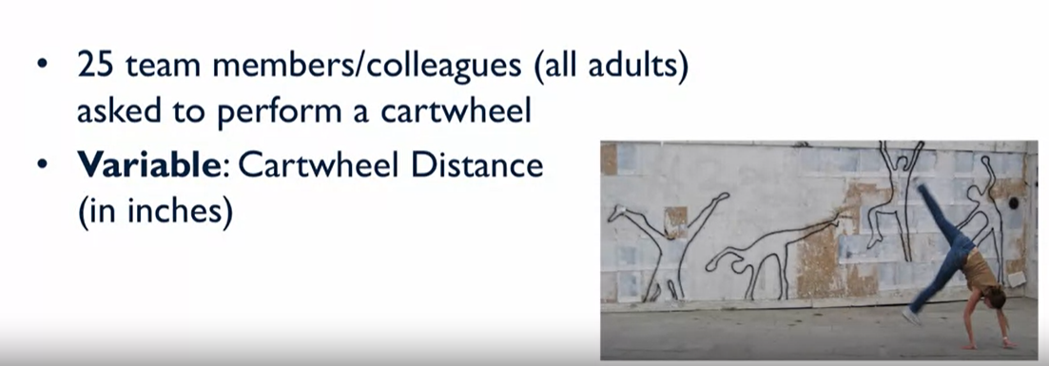
Example 3 : Mean of one population

Slide 17
Research Question
What is the average cartwheel distance(inches) for adults?

Slide 18
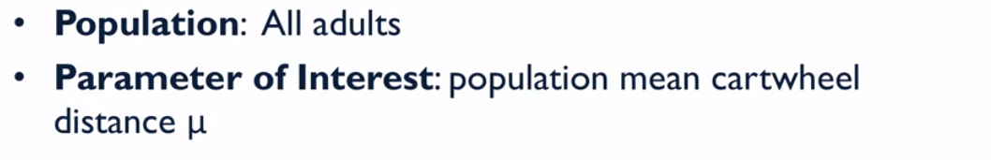
Population and Parameter of Interest

Slide 19
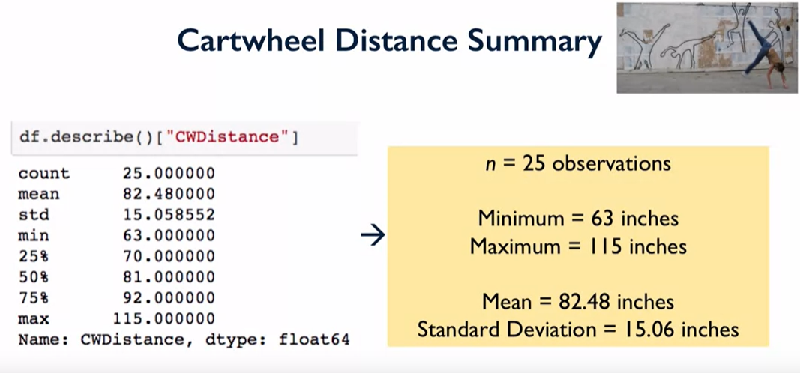
Survey Results

Slide 20
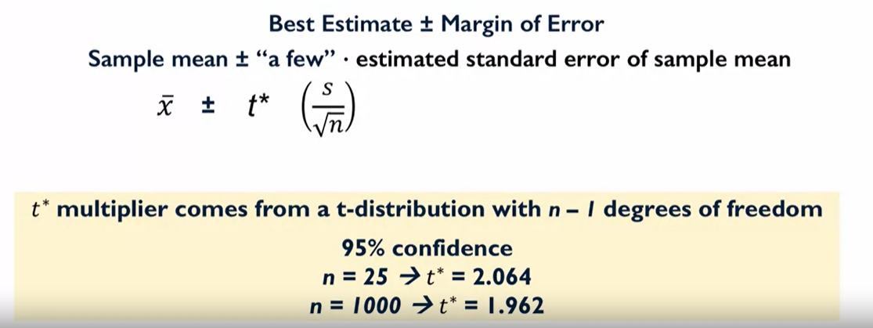
CI Calculation using standard margin of error

Slide 21
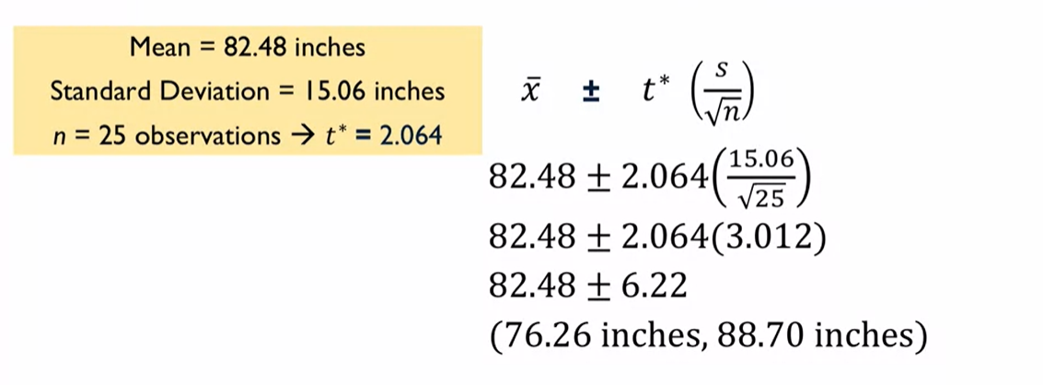
CI Calculation using standard margin of error

Slide 22
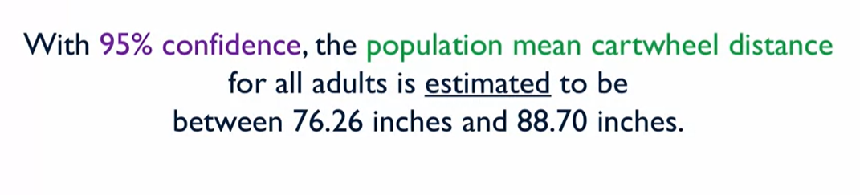
CI Interpretation

Slide 23
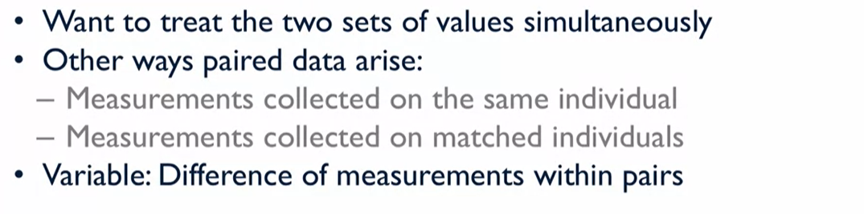
Example 3 : Paired Values

Slide 24
Research Question
What is the average difference between the older twin’s and younger twin’s self reported education level?

Slide 25

Population and Parameter of Interest

Slide 26
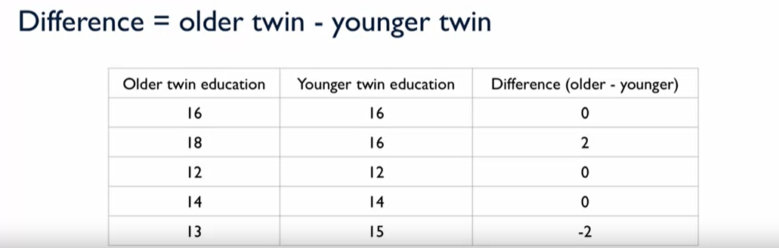
Survey Results

Slide 27
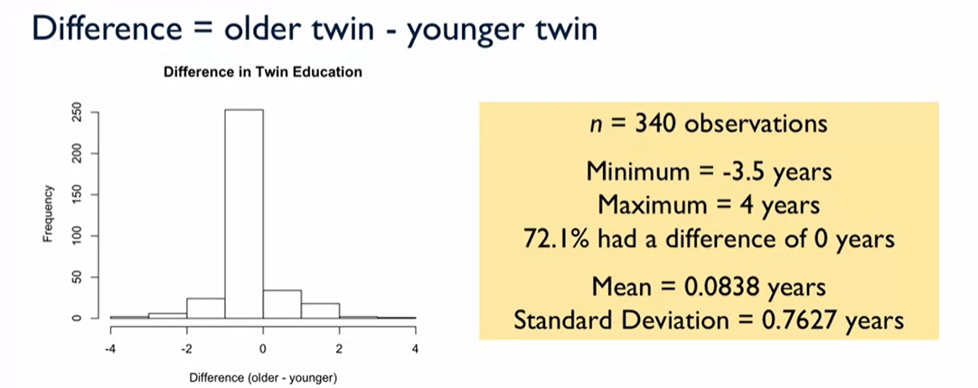
Survey Results

Slide 28
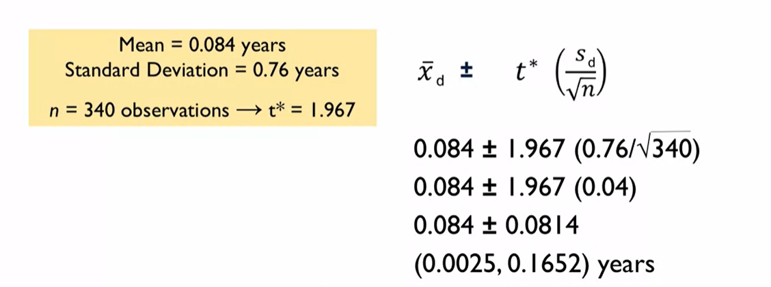
CI Calculation using standard margin of error

Slide 29
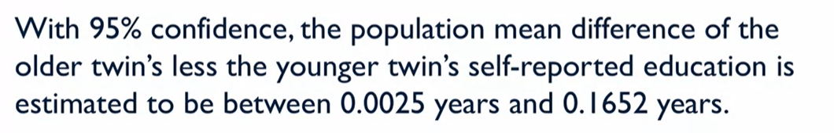
CI Interpretation

Slide 30
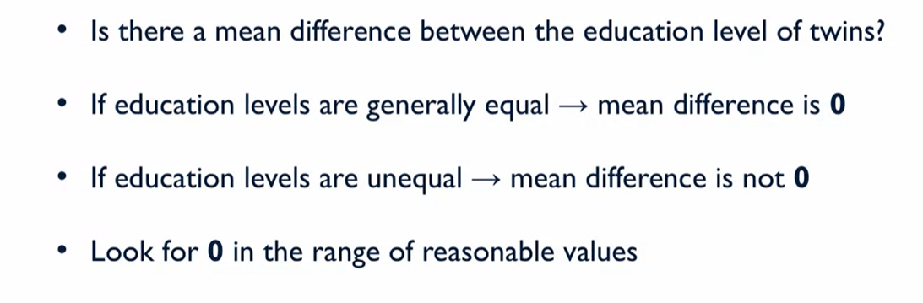
CI Interpretation

Slide 31
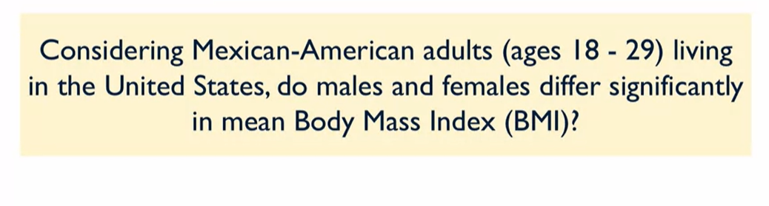
Example 4 : Mean of two population(Independent Groups)

Slide 32
Research Question

Slide 33
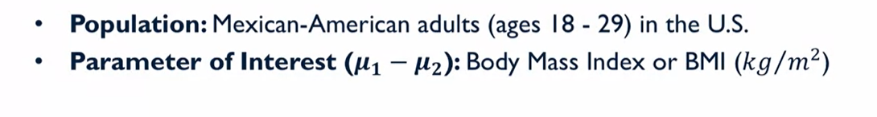
Population and Parameter of Interest

Slide 34
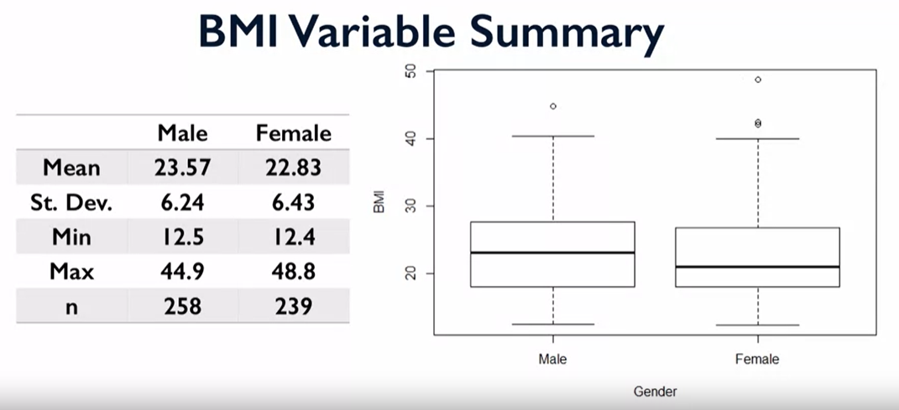
Survey Results

Slide 35
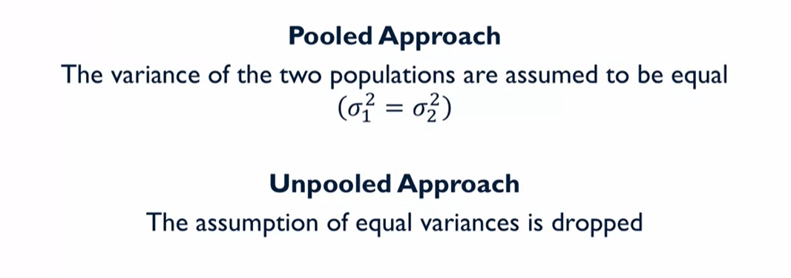
CI Calculation approach

Slide 36
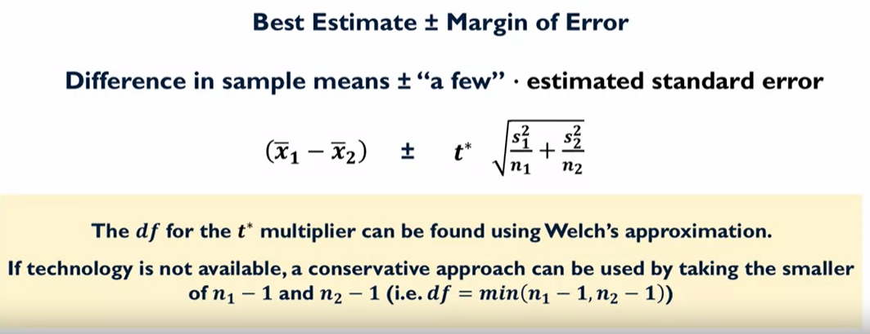
CI Calculation using Unpooled approach

Slide 37
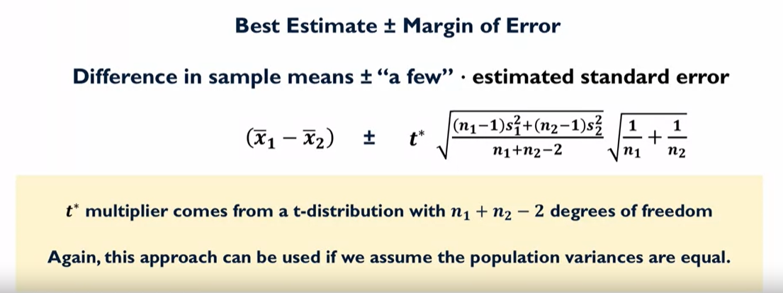
CI Calculation using pooled approach

Slide 38
Steps to identify which method to use
Normailty test
Variance check of two sample populations

Slide 39
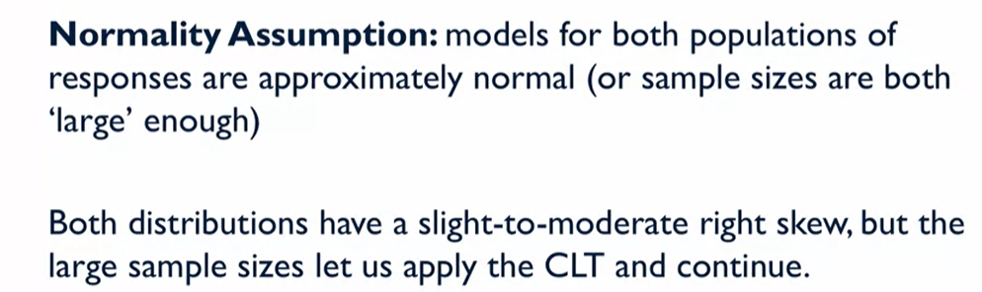
Normailty test

Slide 40
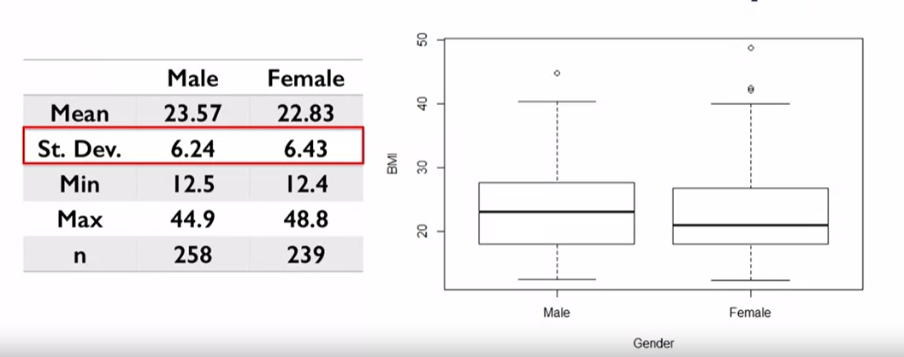
Variance check

Slide 41
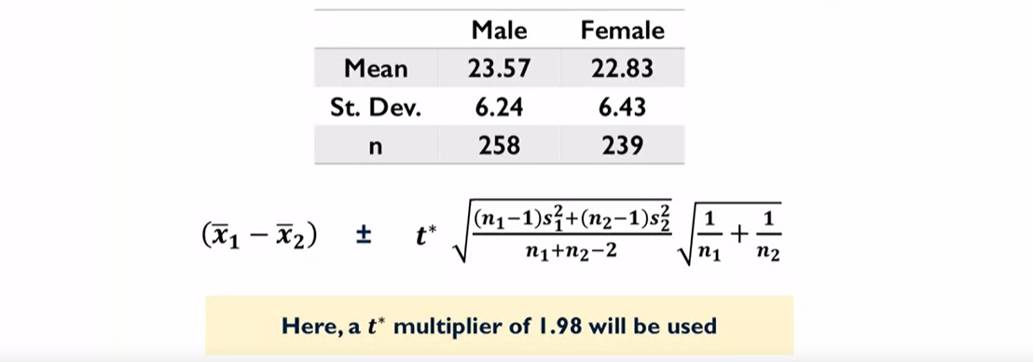
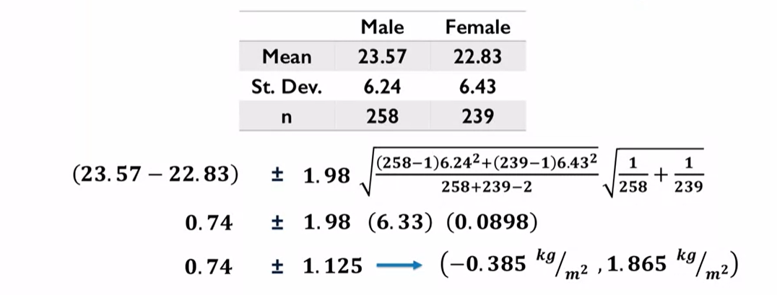
CI Calculation using Pooled approach

Slide 42
CI Calculation using Unpooled approach

Slide 43
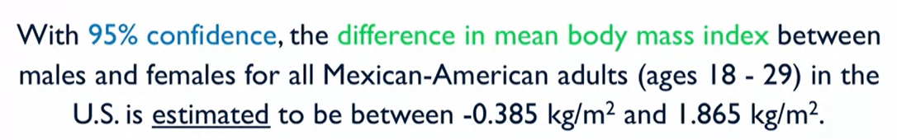
CI Interpretation

Slide 44
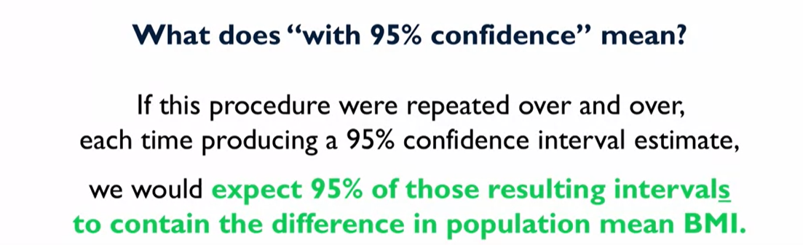
Confidence Level interpretation

Slide 45
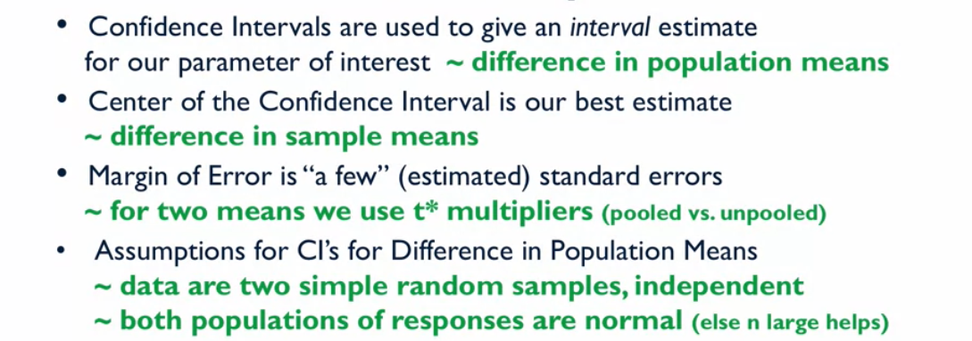
Summary

